Slide 1
Chapter 8: Networks, Fog and Cloud Computing
IOT CƠ BẢN
502068

Slide 2
Ghi chú về bản quyền
Toàn bộ nội dung bài giảng là của CISCO, sinh viên có quyền tải về, lưu trữ, in ấn, tham khảo cho mục đích học tập. Sinh viên không được phát hành lại hay thay đổi nội dung slide nếu chưa có sự đồng ý của chủ sở hữu.
Phần ghi chú ở cuối slide (nếu có) là do các thầy cô ghi chú lại trong quá trình giảng dạy.

Slide 3
Chapter 4: Networks, Fog and Cloud Computing
IoT Fundamentals
Connecting Things 2.01
Notes:
Cisco Networking Academy Program
Connecting Things
Chapter 4: Networks, Fog and Cloud Computing

Slide 4
Chapter 4 - Sections & Objectives
4.1 Connecting Things to the Network
Explain how the network supports the IoT.
4.2 Fog and Cloud Computing
Explain why fog and cloud computing are used in IoT systems.
Notes:
3

Slide 5
4.1 Connecting Things to the Network
Notes:
Cisco Networking Academy Program
Connecting Things
4.1 Connecting Things to the Network

Slide 6
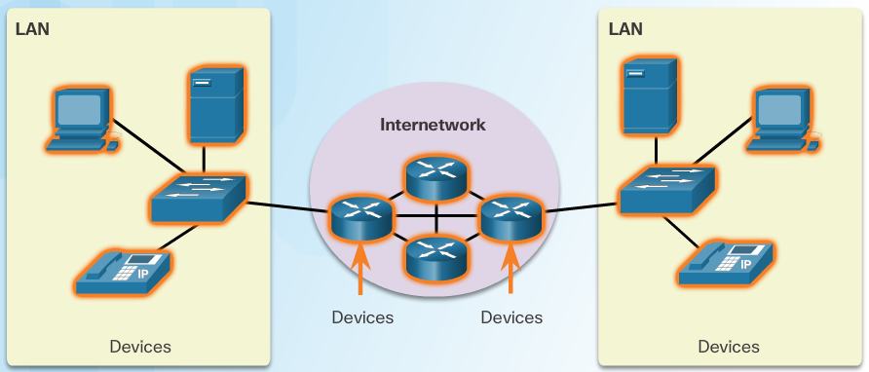
Connecting Things to the Network 4.1.1 The Role of the Network
LAN and WAN
The path from source to destination can be a single cable or a collection of networks.
A Personal Area Network (PAN) is a type of network that usually spans a few meters around an individual and is often used in IoT.
A Local Area Network (LAN) is a type of network infrastructure that spans a small geographical area and is used to connect end devices..
A LAN is normally a high-speed network under the control of a single administrative entity.
A Wide Area Network (WAN) is a type of network infrastructure that spans a wide geographical area and is used to connect WANs.
A WAN is normally a low-speed network and may include portions from different Internet Service Providers (ISPs)
LANs often connect machines in the factory plant.
WAN devices have evolved to create Low PowerWide Area Networks (LPWAN) for use in the IOT
Notes:
4.1 – Connecting Things to the Network
4.1.1 – The Role of the Network

Slide 7
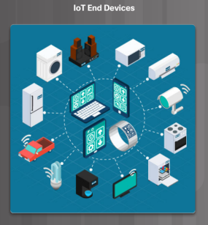
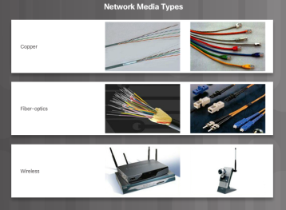
Connecting Things to the Network The Role of the Network (Cont.)
Network Devices and Communication Media
Network devices are devices that connect to each other through a network.
An end device is either the source or destination of a message transmitted over the network.
Intermediary devices connect the individual end devices to the network and can connect multiple individual networks to form an internetwork.
Network addresses are used to uniquely identify devices on a network.
Network media provide the physical channel over
which the message travels from source to destination.
Notes:
4.1 – Connecting Things to the Network
4.1.1 – The Role of the Network (Cont.)

Slide 8
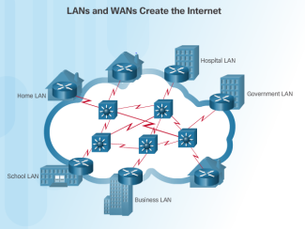
Connecting Things to the Network The Role of the Network (Cont.)
Network Protocols
Devices must conform to common protocols before they can communicate.
Two very important network protocols are Ethernet and IP.
Ethernet rules enable communication between local devices.
IP enable communication between remote devices.
Basic Routing
Network packets must often transverse several networks to get to the destination.
Routing is the process of directing a network packet to its destination.
Routers are intermediary network devices that perform routing.
LANs, WANs and the Internet
Single router designs are common in SOHO.
The single router connects SOHO devices to the Internet.
The single router is the default gateway for all SOHO devices.
Notes:
4.1 – Connecting Things to the Network
4.1.1 – The Role of the Network (Cont.)

Slide 9
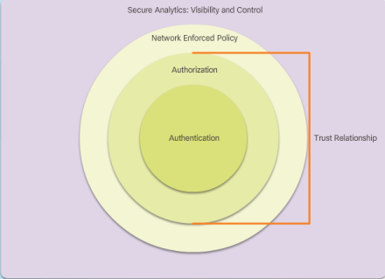
Connecting Things to the Network The Role of the Network (Cont.)
IoT Protocols
IoT Devices are often embedded devices designed to work in sub-optimal conditions.
These devices require specialized protocols to function with low power and limited connectivity.
IoT devices use CoAP (Constrained Application Protocol) and MQTT (Message Queuing Telemetry Transport).
Securing the Network
IoT devices are integrated into all aspects of daily life.
IoT applications carry traceable signatures and carry confidential data.
IoT devices must adhere to a secure framework (Authentication, Authorization, Network Enforced Policy, Secure Analytics)
Notes:
4.1 – Connecting Things to the Network
4.1.1 – The Role of the Network (Cont.)

Slide 10
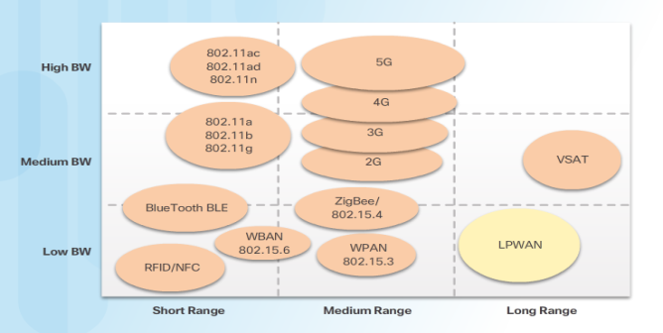
Connecting Things to the Network 4.1.2 Wireless Technologies
WiFi
Wireless connectivity is the biggest growth area.
New protocols created/updated to support diverse IoT devices: ZigBee, Bluetooth, 4G/5G, LoRaWAN
Protocols created for short, medium, and wide ranges
Low-Power Wide-Area Networks (LPWAN) is designed to support long range communications for low bit rate devices such as sensors, actuators, and controllers

Slide 11
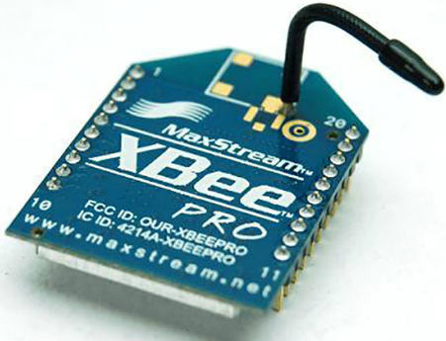
Connecting Things to the Network Wireless Technologies (cont’d)
ZibBee
A low-energy, low-power, low-data rate wireless protocol specification used to create personal area networks
Areas of utilization: home automation, medical device data collection, and other low-power low-bandwidth needs
250 kbps transfer rate best suited for intermittent data transmissions
Every ZigBee data request uses an Application Profile Identification Number.
Application profile ID numbers - 16-bit numbers that relate to public profiles, manufacturing profiles, or private profiles.
ZigBee version 1.2 has a number of serious and exploitable security vulnerabilities. Most of these protocol design flaws relate to attempts to make it easier for the end-user to add a ZigBee device to the ZigBee network.

Slide 12

Connecting Things to the Network Wireless Technologies (cont’d)
Bluetooth
Wireless protocol used for data communication over short distances (PAN)
Supported by almost all mobile devices and accessories - the defacto standard for audio between mobile devices.
Bluetooth Low Energy (BLE) - very popular because of the smartphone industry and new applications in healthcare, fitness, and beacons.
operates in the 2.4 GHz ISM band
Has a very fast connection rate (milliseconds) and a very high data rate (1 Mbps).
The BLE device then goes into “sleep mode” until a connection is reestablished -lengthens the battery life for several years.
Beacons use BLE technology - positioned on buildings, in coffee shops, and on light posts to provide location services.

Slide 13
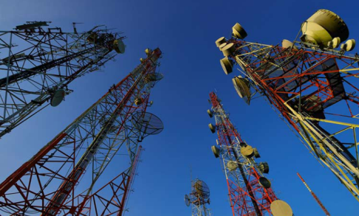
Connecting Things to the Network Wireless Technologies (cont’d)
4G/5G
Cellular-based data networks designed to take advantage of communications over large geographic areas
High mobility bandwidth (trains and cars) of 4G system is 100 Mbps
Low mobility (pedestrians and stationary users) of 4G systems is 1 Gbps
4G provides support for voice, IP telephony, mobile Internet access, video calling, gaming services, cloud computing, high-definition mobile TV, and mobile 3D TV.
Long Term Evolution (LTE) and WiMAX (IEEE 802.16e) are two popular 4G systems.
LTE 4G technology release 13e includes the standardization of NarrowBand IoT (NB-IoT) - an LPWAN technology.
Next Generation Mobile Networks Alliance defining the standards and requirements for 5G

Slide 14
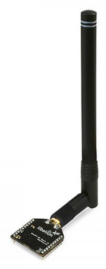
Connecting Things to the Network Wireless Technologies (cont’d)
LoRaWAN
Wireless technology designed to provide wireless WAN connections to power constricted devices.
targets key requirements of the Internet of Things such as secure bi-directional communication, mobility and localization services.
Architecture is often an extended star topology in which gateways relay messages between end-devices and a central network server is located in the backend.
Data rates range from 0.3 kbps to 50 kbps
Security is built into the LoRaWAN standard, implemented in a multi-layer encryption scheme.
Unique keys are used in the Application, Network, and Device layers.

Slide 15
4.2 Fog and Cloud Computing
Notes:
Cisco Networking Academy Program
Connecting Things
4.2 Fog and Cloud Computing

Slide 16
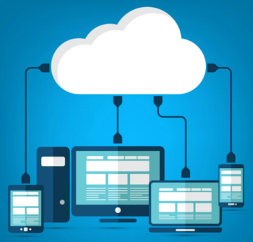
Connecting Things to the Network 4.2.1 Fog and Cloud Services
Cloud Computing Model
On-demand access to a shared pool of configurable computing resources.
Resources can be made available quickly with minimal management effort.
Cloud service providers use data centers for their cloud services and cloud-based resources.
“Pay-as-you-go” model treats computing and storage expenses as a utility.
Enables access to organizational data and applications anywhere and at any time
Reduces cost for equipment, energy, physical plant requirements, and personnel training needs
Cloud services offered: Infrastructure as a Service (IaaS), Platform and mobile Platform as a Service (PaaS) (mPaaS), Software as a Service (SaaS)

Slide 17
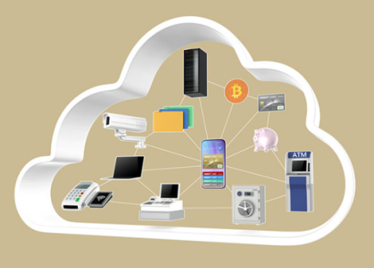
Connecting Things to the Network Fog and Cloud Services (cont’d)
Cloud Services
Cloud customers have access to a shared pool of configurable computing resources that can be rapidly provisioned and released with minimal management effort.
Extends functionality of an IoT system: data processing and storage done in the cloud instead of in the IoT devices.
Data and resources - always available to any device in the system as long as the device has Internet connectivity
Cloud service providers are also very serious about security, ensuring customer data is kept safe and secure..
Examples of cloud services: Amazon AWS, IFTTT, Zapier, Built.io, Webex Teams

Slide 18
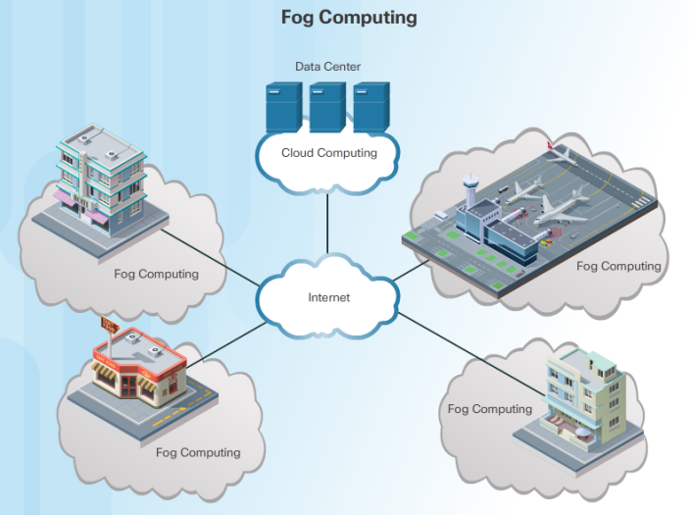
Connecting Things to the Network Fog and Cloud Services (cont’d)

Slide 19
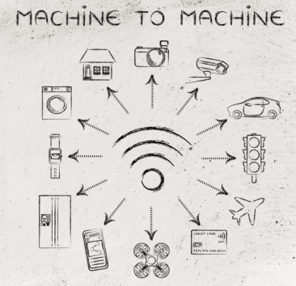
Connecting Things to the Network Fog and Cloud Services (cont’d)
Fog Computing Model
Distributed computing infrastructure closer to the network edge.
Edge devices run applications locally and make immediate decisions
Reduces the data burden on networks as raw data not sent over network connections.
Enhances security - keeping sensitive data from being transported beyond the edge where it is needed.
Fog applications monitor or analyze real-time data from network-connected things and then take action such as locking a door, changing equipment settings, applying the brakes on a train, zooming in with a video camera,
The action can involve machine-to-machine (M2M) communications and machine-to-people (M2P) interaction
Cisco predicts that 40% of IoT-created data will be processed in the fog by 2018

Slide 20
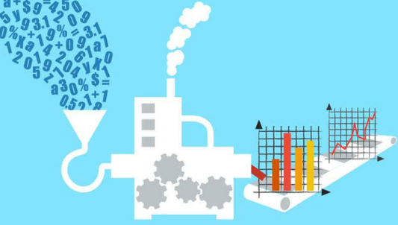
Connecting Things to the Network 4.2.2 Big Data (cont’d)
Data Growth
Number of sensors and other IoT end devices growing exponentially and collecting a constant stream of data.
Consumer behavior is changing requires anytime, anywhere, on-demand access.- fitness monitors, smartphones, medical devices
Smart cities and smart grids, connected trains, cars – growing in frequency
Problems arise in terms of the requirements for storage, analysis, and security

Slide 21

Connecting Things to the Network 4.2.2 Big Data (cont’d)
It is All About the Data
Big data is data that is so vast and complex it is difficult to store, process, and analyze using traditional data storage and analytics applications.
Typically characterized in three dimensions: volume, velocity, and variety
Volume - the amount of data being transported and stored
Velocity - the rate at which this data is generated
Variety - the type of data, which is rarely in a state that is perfectly ready for processing and analysis
Apache Hadoop, Webex Teams, Cassandra, and Kafka – examples of open source projects dealing with Big Data

Slide 22

Connecting Things to the Network 4.2.3 Security Concerns in the IoT
Data Storage
IoT devices may store data for a period of time before sending it out for processing. – especially for devices that do not maintain constant connections to their gateways or controllers.
Critical that all IoT storage devices encrypt data for storage to avoid data tampering or theft
Self-encrypting drives have encryption capability built into the drive controller - encryption and decryption done by the drive itself, independent of the operating system.
Self-encrypting flash memory – manufacturers beginning to release new devices with self-encrypting flash memory

Slide 23
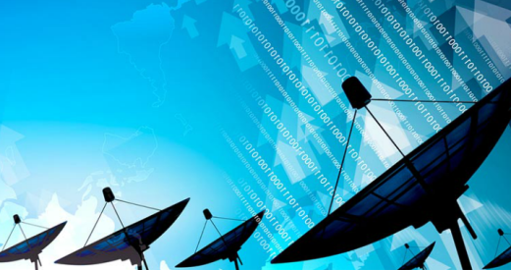
Connecting Things to the Network 4.2.3 Security Concerns in the IoT (cont’d)
Data Transmission
If data is not properly secured through encryption, it can be intercepted, captured or manipulated while in transit.
Modern encryption algorithms may require more processing power than what is available in the IoT device.
As well as physical security, IoT devices must be able to protect its own firmware and the data it transmits.
Ensure that IoT devices are running the latest version of their firmware and protocols.
Common attack: trick devices into using sub-optimal security parameters under which the connection can be exploited
Servers, cloud endpoints, intermediary devices should also be secured and use strong encryption algorithms before communicating with IoT devices.

Slide 24
4.3 Chapter Summary
Notes:
Cisco Networking Academy Program
Connecting Things
Chapter 4: Networks, Fog and Cloud Computing

Slide 25
Chapter Summary Summary
Personal information related to health, location, wealth, personal preferences and behaviors is passing through the IoT devices in increasing volumes. This increase in volume elevates the relevance of increasing the attention on data privacy and data protection.
New wireless technologies and protocols, such as ZigBee, Bluetooth, 4G/4G, and LoRaWAN, have been developed to accommodate the diversity of IoT devices. Wireless technology is selected based on the range of coverage, bandwidth requirements, power consumption, and deployment location.
Wireless security considerations include: selecting a secure protocol, protection for management frames, identification of frequency jamming, detecting rogue access points, and using security at the application layer.
Cloud computing is a service that offers off-premise, on-demand access to a shared pool of configurable computing resources. Cloud computing offers services such as IaaS, PaaS, mPaaS and SaaS.
A fog computing model identifies a distributed computing infrastructure closer to the network edge. It enables edge devices to run applications locally and make immediate decisions.
The proliferation of devices in the IoT is one of the primary reasons for the exponential growth in data generation. Data can be deemed at rest or in motion. Big Data is typically characterized in three dimensions: volume, velocity, and variety.
Data stored in servers must be encrypted to avoid data tampering or theft. Regular backups are mandatory to minimize losses in case of a disaster
IoT devices should run the latest version of firmware and protocols and any communication between devices should be done using protocols that provide secure encryption by default.

Slide 26


Slide 27


